Slide 1
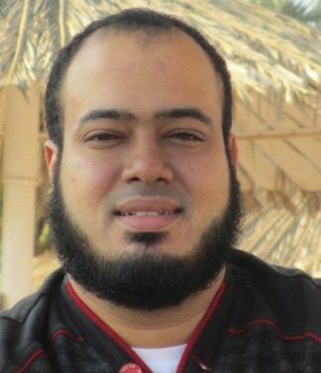
Competitive Programming From Problem 2 Solution in O(1)
P
T
H
I
N
K
F
A
S
T
S
C++: Pointers 3
Mostafa Saad Ibrahim
PhD Student @ Simon Fraser University

Slide 2
Where the variables in memory?
We create:
Local Variables
Fixed size arrays
Dynamic arrays
Static variables
Global variables

Slide 3
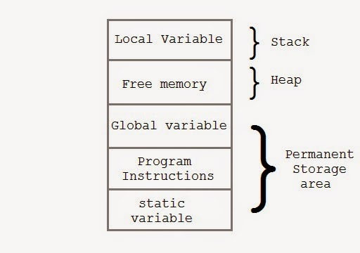
Memory
Notes:
Src: http://latestcomputing.blogspot.ca/2014/08/memory-stack-vs-heap.html

Slide 4

Stack
Imagine putting books
One above another
Now, I ask you to get a book
You can’t get last one
You can get top one
This is stack structure
Notes:
Src: http://quincypublicschools.com/library/files/2011/08/book-stack.png

Slide 5
The run-time stack
The run-time stack is stack of function calls
When we call function, it enters stack. When we finish function, we remove it from stack
Stack will have all details for the function
What are sent parameters
What are local parameters?
Who/Where called us and waiting our return

Slide 6
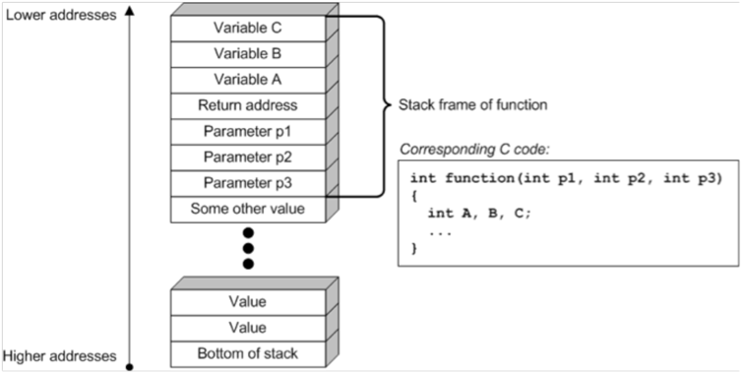
The run-time stack
Notes:
Src: http://twimgs.com/ddj/images/article/2012/0612/stack1.gif

Slide 7
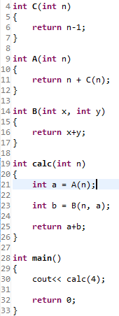
The run-time stack
Run Time Stack

Slide 8
The run-time stack
Main()
Run Time Stack

Slide 9
The run-time stack
Main()
Line 30: Calc(4)
Run Time Stack

Slide 10
The run-time stack
Calc(n=4, Called from line 30)
Main()
Line 30: Calc(4)
Run Time Stack

Slide 11
The run-time stack
Calc(n=4, Called from line 30)
Line 21: a = A(4)
Main()
Line 30: Calc(4)
Run Time Stack

Slide 12
The run-time stack
A(n=4, Called from line 21)
Calc(n=4, Called from line 30)
Line 21: a = A(4)
Main()
Line 30: Calc(4)
Run Time Stack

Slide 13
The run-time stack
A(n=4, Called from line 21)
Line 11: return 4 + C(4)
Calc(n=4, Called from line 30)
Line 21: a = A(4)
Main()
Line 30: Calc(4)
Run Time Stack

Slide 14
The run-time stack
C(n=4, Called from line 11)
A(n=4, Called from line 21)
Line 11: return 4 + C(4)
Calc(n=4, Called from line 30)
Line 21: a = A(4)
Main()
Line 30: Calc(4)
Run Time Stack

Slide 15
The run-time stack
C(n=4, Called from line 11)
return to line 11 with: 4-1
A(n=4, Called from line 21)
Line 11: return 4 + C(4)
Calc(n=4, Called from line 30)
Line 21: a = A(4)
Main()
Line 30: Calc(4)
Run Time Stack

Slide 16
The run-time stack
A(n=4, Called from line 21)
Line 11: return 4 + 3
Calc(n=4, Called from line 30)
Line 21: a = A(4)
Main()
Line 30: Calc(4)
Run Time Stack

Slide 17
The run-time stack
Calc(n=4, Called from line 30)
Line 21: a = 7
Main()
Line 30: Calc(4)
Run Time Stack

Slide 18
The run-time stack
Calc(n=4, Called from line 30)
Line 21: a = 7
Line 23: b = B(4, 7)
Main()
Line 30: Calc(4)
Run Time Stack

Slide 19
The run-time stack
B(x=4, y=7, Called from line 23)
Calc(n=4, Called from line 30)
Line 21: a = 7
Line 23: b = B(4, 7)
Main()
Line 30: Calc(4)
Run Time Stack

Slide 20
The run-time stack
B(x=4, y=7, Called from line 23)
return 4+7
Calc(n=4, Called from line 30)
Line 21: a = 7
Line 23: b = B(4, 7)
Main()
Line 30: Calc(4)
Run Time Stack

Slide 21
The run-time stack
Calc(n=4, Called from line 30)
Line 21: a = 7
Line 23: b = 11
Main()
Line 30: Calc(4)
Run Time Stack

Slide 22
The run-time stack
Calc(n=4, Called from line 30)
Line 21: a = 7
Line 23: b = 11
return 7+11
Main()
Line 30: Calc(4)
Run Time Stack

Slide 23
The run-time stack
Main()
Line 30: 18
Run Time Stack

Slide 24
The run-time stack
Main()
Line 30: 18
Line 32: return 0
Run Time Stack

Slide 25
The run-time stack
Program Terminated
Run Time Stack

Slide 26
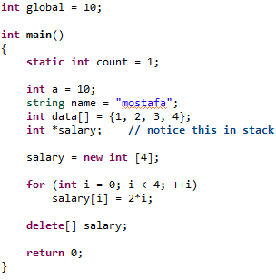
Stack, Heap and data segment
Dynamic memory in the heap
Main()
int a = 10;
string name;
int data[] = {1, 2, 3, 4}
int *salary;
Stack
0 | 2 | 4 | 8
Heap
Int global = 10
Statcit int count = 1
Data segment

Slide 27
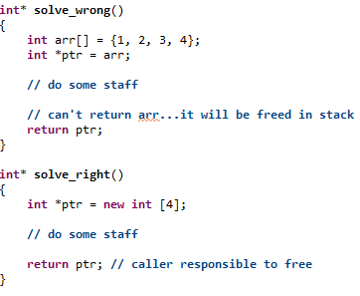
Never return stack data!

Slide 28
Stack vs Heap
Stack is limited in size
Local variables – Can’t resize – managed by CPU
It is fast as it puts in consective blocks in stack
Whenever needs large array, ALWAYS use heap data
Heap has much more memory space
It is not consective. May cause fragements
Manage by yourself - It may cause memory leaks
Slower
There are too much to read about that..
Google with “What and where are the stack and heap?”

Slide 29
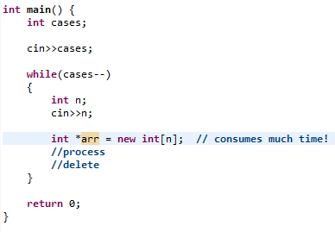
Competitions & Pointers: Don’t

Slide 30
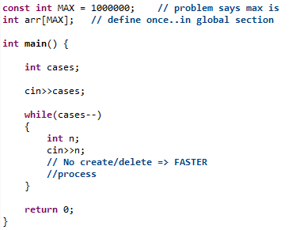
Competitions & Pointers: Do

Slide 31
تم بحمد الله
علمكم الله ما ينفعكم
ونفعكم بما تعلمتم
وزادكم علماً

